Slide 1
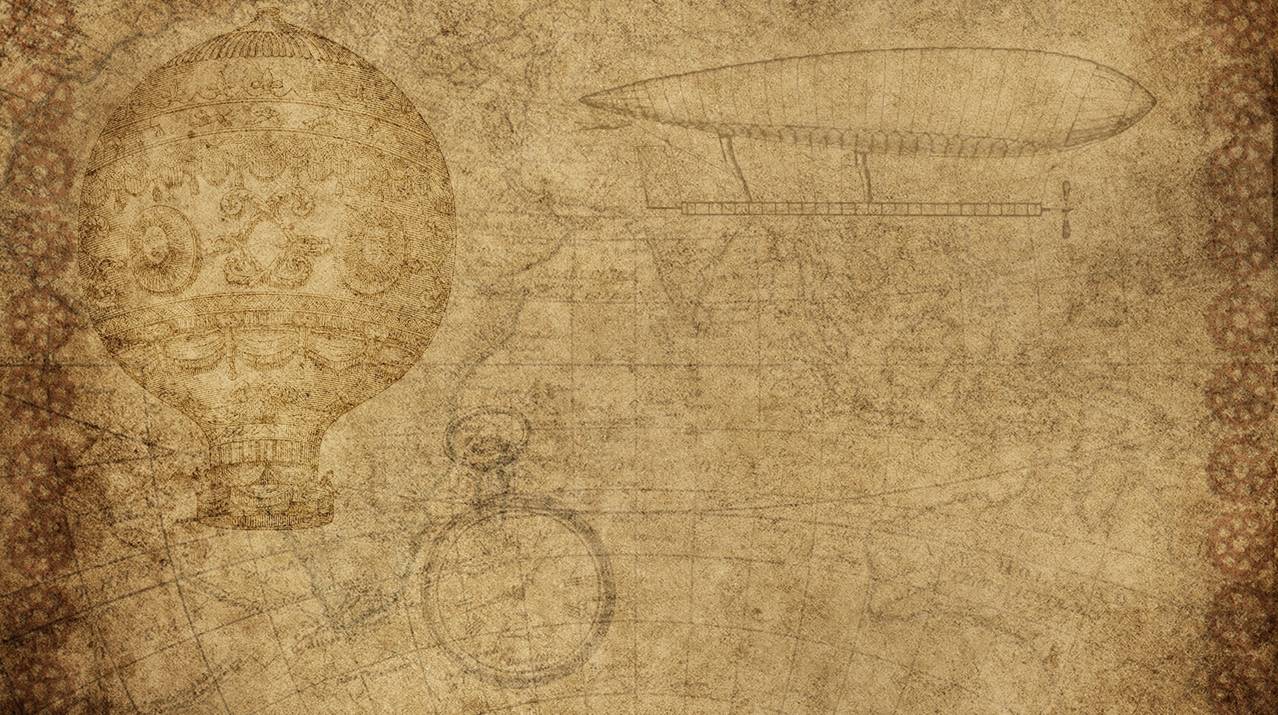

Optimized Warehouse Management of perishable goods for a food delivery company
Sakshee sawant
Srishti vazirani
Riddhi khole

Slide 2
Features of the project
Get Started Now - Predicts the future sales of the products in the warehouse.
Talk with Chatbot - User-friendly bot which helps the viewer understand our system better and answer any queries.
Click Here To Place Order - Small scale orders can be placed here via a Google form.
View Products - Details of products currently available in the warehouse is shown.
Click Here for placing Bulk Orders – Restaurants and other services can place the bulk orders here.

Slide 3
Block diagram
Google form
Website
Chatbot
Sales prediction
Trained dataset
Predicted data
ML model

Slide 4
flowchart
Data collation
Data processing
Building UI
Learning ML
Connecting UI and model
Training model
Creating ML model

Slide 5
THANK YOU

